Slide 1


Predicting Hospital Readmission Risk
An End-to-End Machine Learning Project with a Deployed Web Application
Team (MB6)3_1

Slide 2




Why Predict Hospital Readmission?
Hospital readmissions pose a significant challenge to healthcare systems worldwide. Early identification of high-risk patients allows providers to intervene, improving outcomes and optimizing resource allocation.
Increased Costs
Reduced Patient Care
Hospital Penalties
Readmissions drive up healthcare expenditures, straining budgets and resources.
Frequent readmissions indicate gaps in care quality and patient well-being.
Hospitals often face financial penalties for high readmission rates, impacting their sustainability.

Slide 3
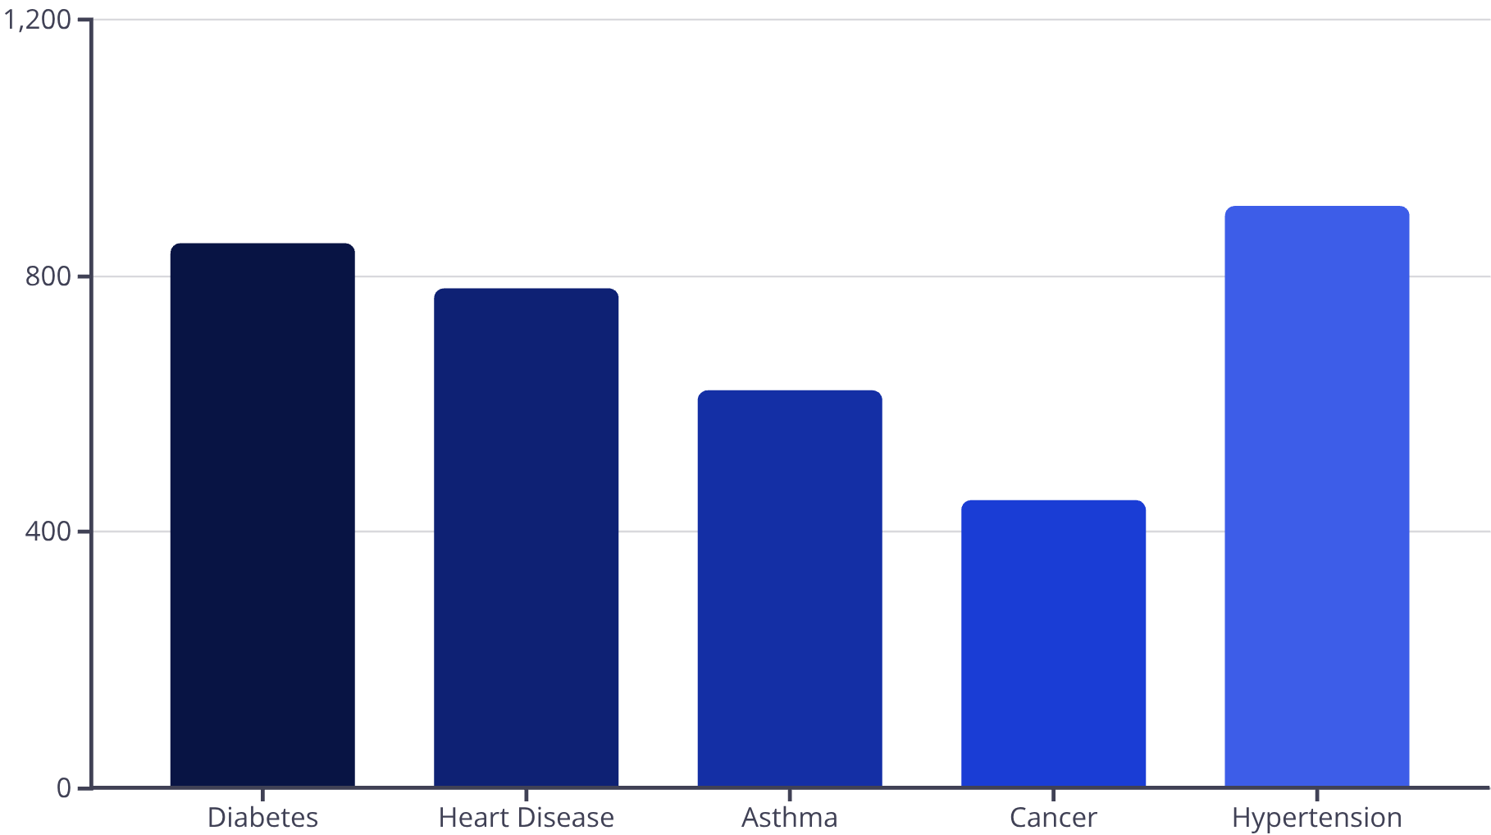

Understanding Our Data
Our project utilized a simulated healthcare_dataset.csv to model patient readmission risk. Initial analysis focused on key features that could indicate potential risk factors.
Key Features Analyzed:
Age: Patient's age at admission.
Medical Condition: Primary diagnosis upon admission.
Admission Type: How the patient was admitted (e.g., Emergency, Elective).
Test Results: Outcomes of critical lab tests (e.g., Normal, Abnormal).

Slide 4





From Data to Prediction
A "High Risk" target variable was engineered based on a set of predefined rules. A patient was flagged as high risk for readmission only if all four rules below were met.
Rule 1: Age
Rule 2: Condition
Patient age > 65 years
Specific chronic conditions (Cancer, Diabetes, Heart Disease)
Rule 3: Admission
Rule 4: Test Results
Admission Type: Emergency or Elective
Test results: Abnormal or Inconclusive
If all conditions are met, the patient is flagged High Risk.

Slide 5
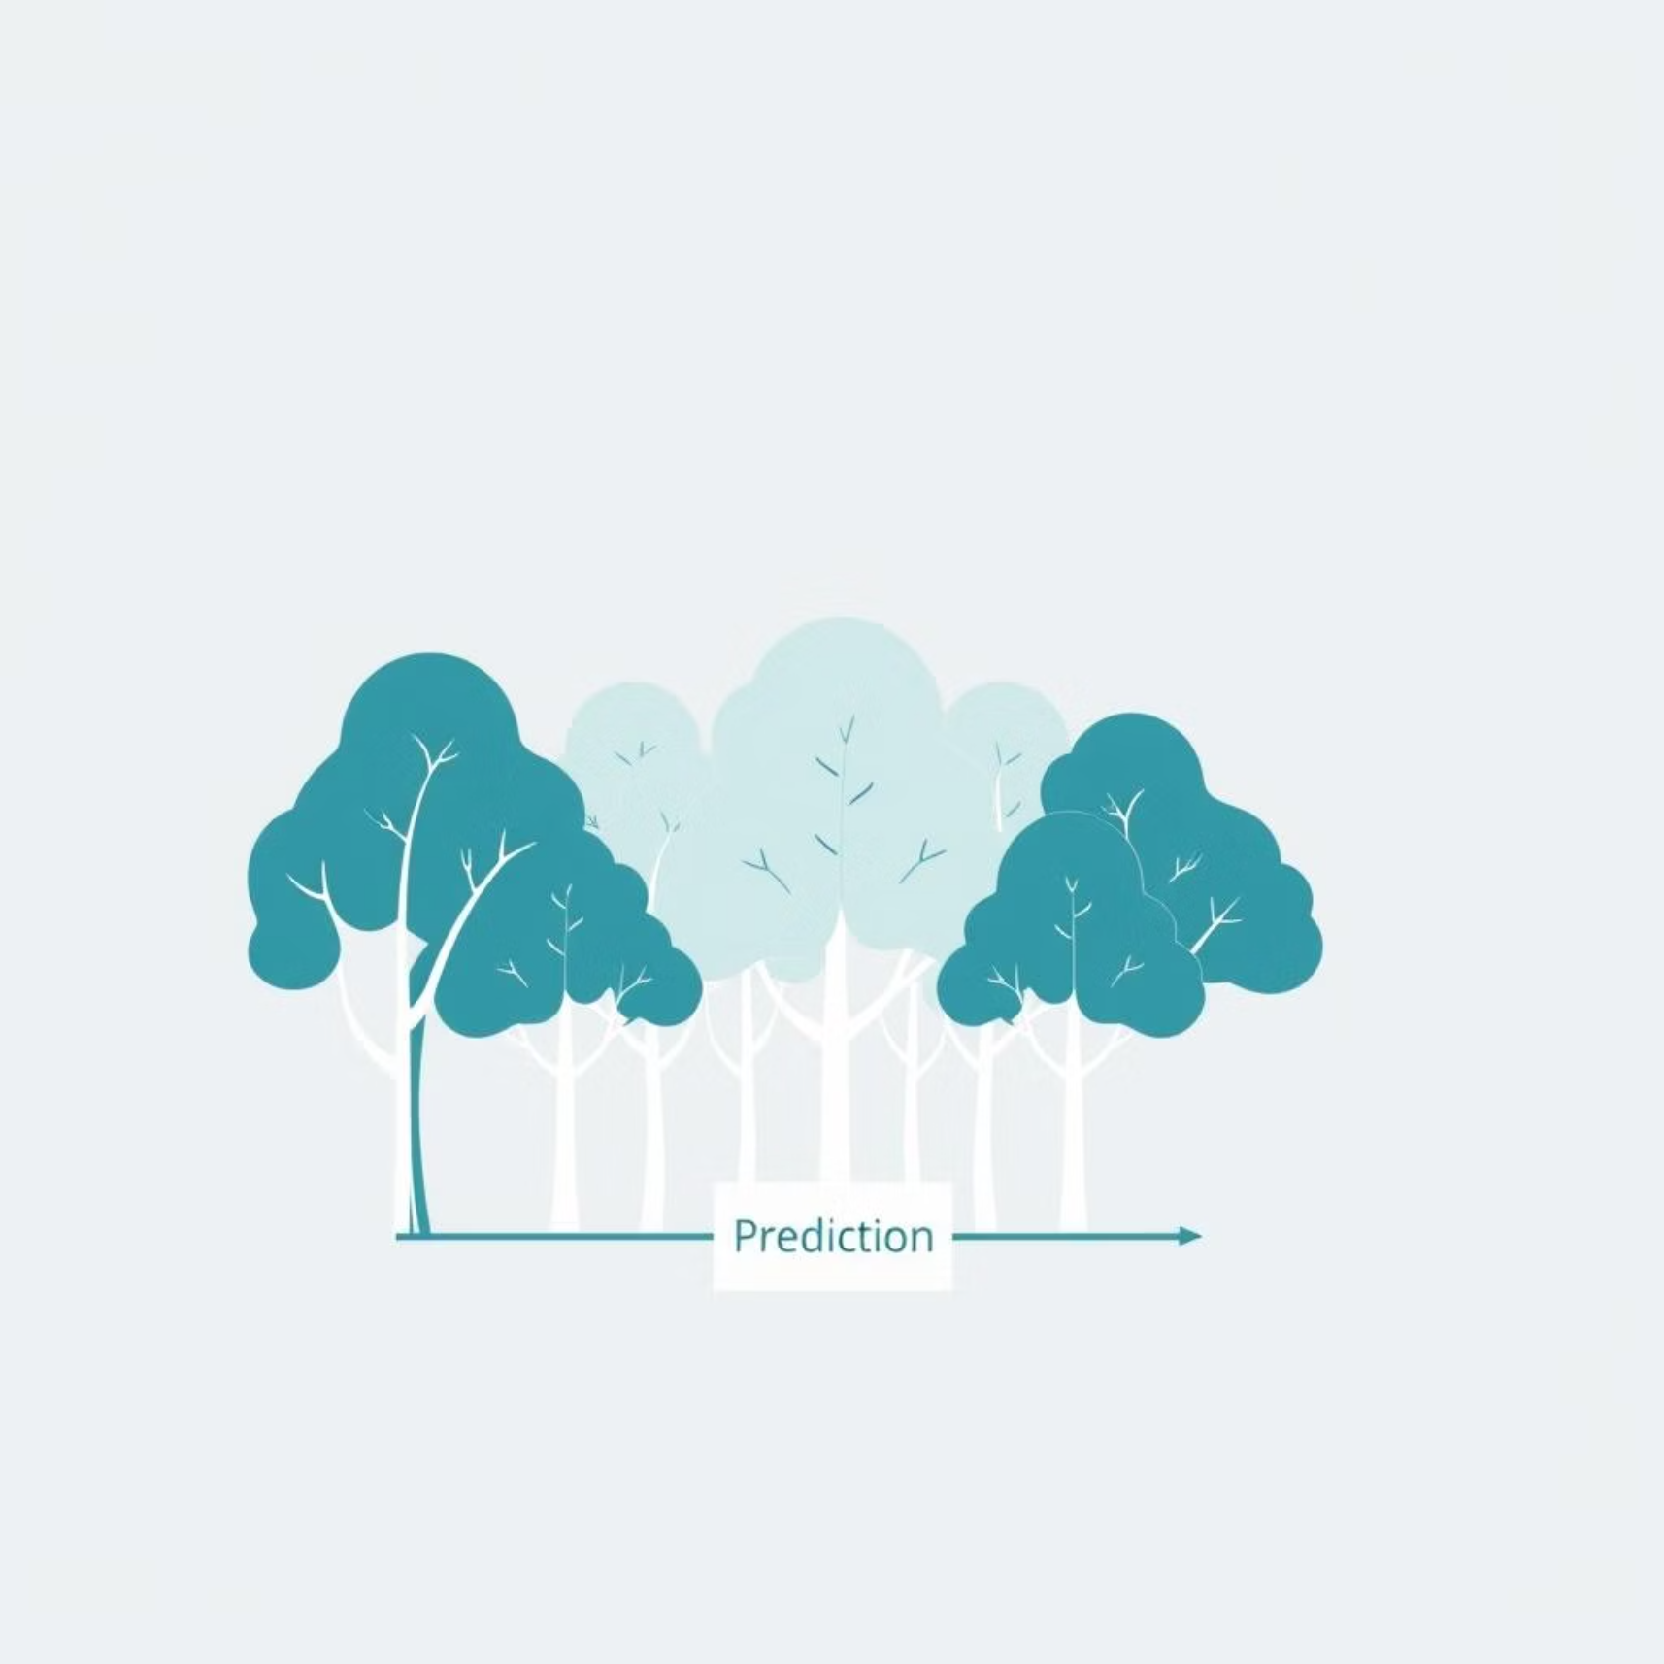

Our Chosen Model: Random Forest
A Random Forest Classifier was trained to identify patterns in the data and predict readmission risk. This powerful ensemble model combines the strengths of many individual decision trees.
A Random Forest is like a committee of many individual decision trees. Each tree makes its own "vote" or prediction, and the forest then combines these votes to arrive at a final, more robust prediction. This approach enhances accuracy and reduces overfitting.
The trained model was saved as a readmission_model.pkl file, ready for seamless deployment into our application.

Slide 6
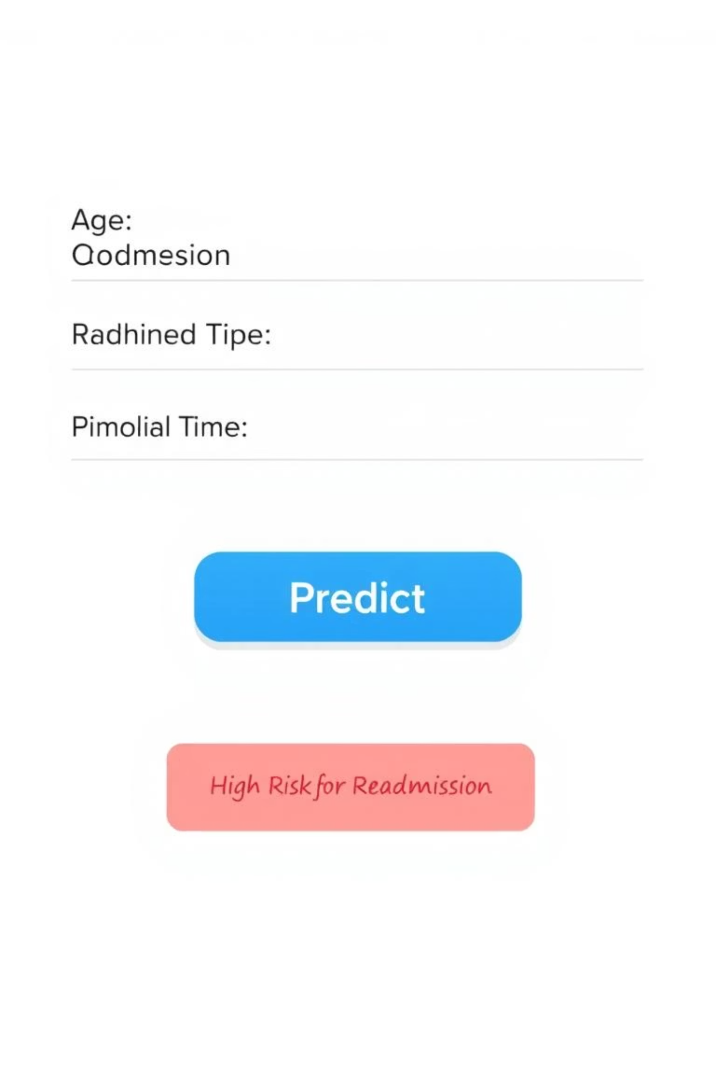
Live Demo: The Readmission Predictor App
We developed an interactive web application using Streamlit, designed to provide an intuitive interface for healthcare professionals to assess readmission risk in real-time.
This tool empowers doctors and hospital staff to obtain instant predictions by simply entering patient data, facilitating proactive interventions and improved patient care planning.

Slide 7

Conclusion & Next Steps
We successfully built and deployed a machine learning model to predict hospital readmission risk, culminating in an accessible web application. Our journey continues with ambitious goals to refine and enhance the model's capabilities.
Achievements
Future Work
Model Built: Developed a robust Random Forest model for risk prediction.
Use Real Data: Train the model on actual readmission outcomes to move beyond rule-based logic and capture more nuanced patterns.
Web App Deployed: Launched an interactive Streamlit application for ease of use.
Add More Features: Incorporate additional relevant patient attributes, such as socio-economic factors, comorbidities, and historical treatment data, for improved accuracy.

Slide 8
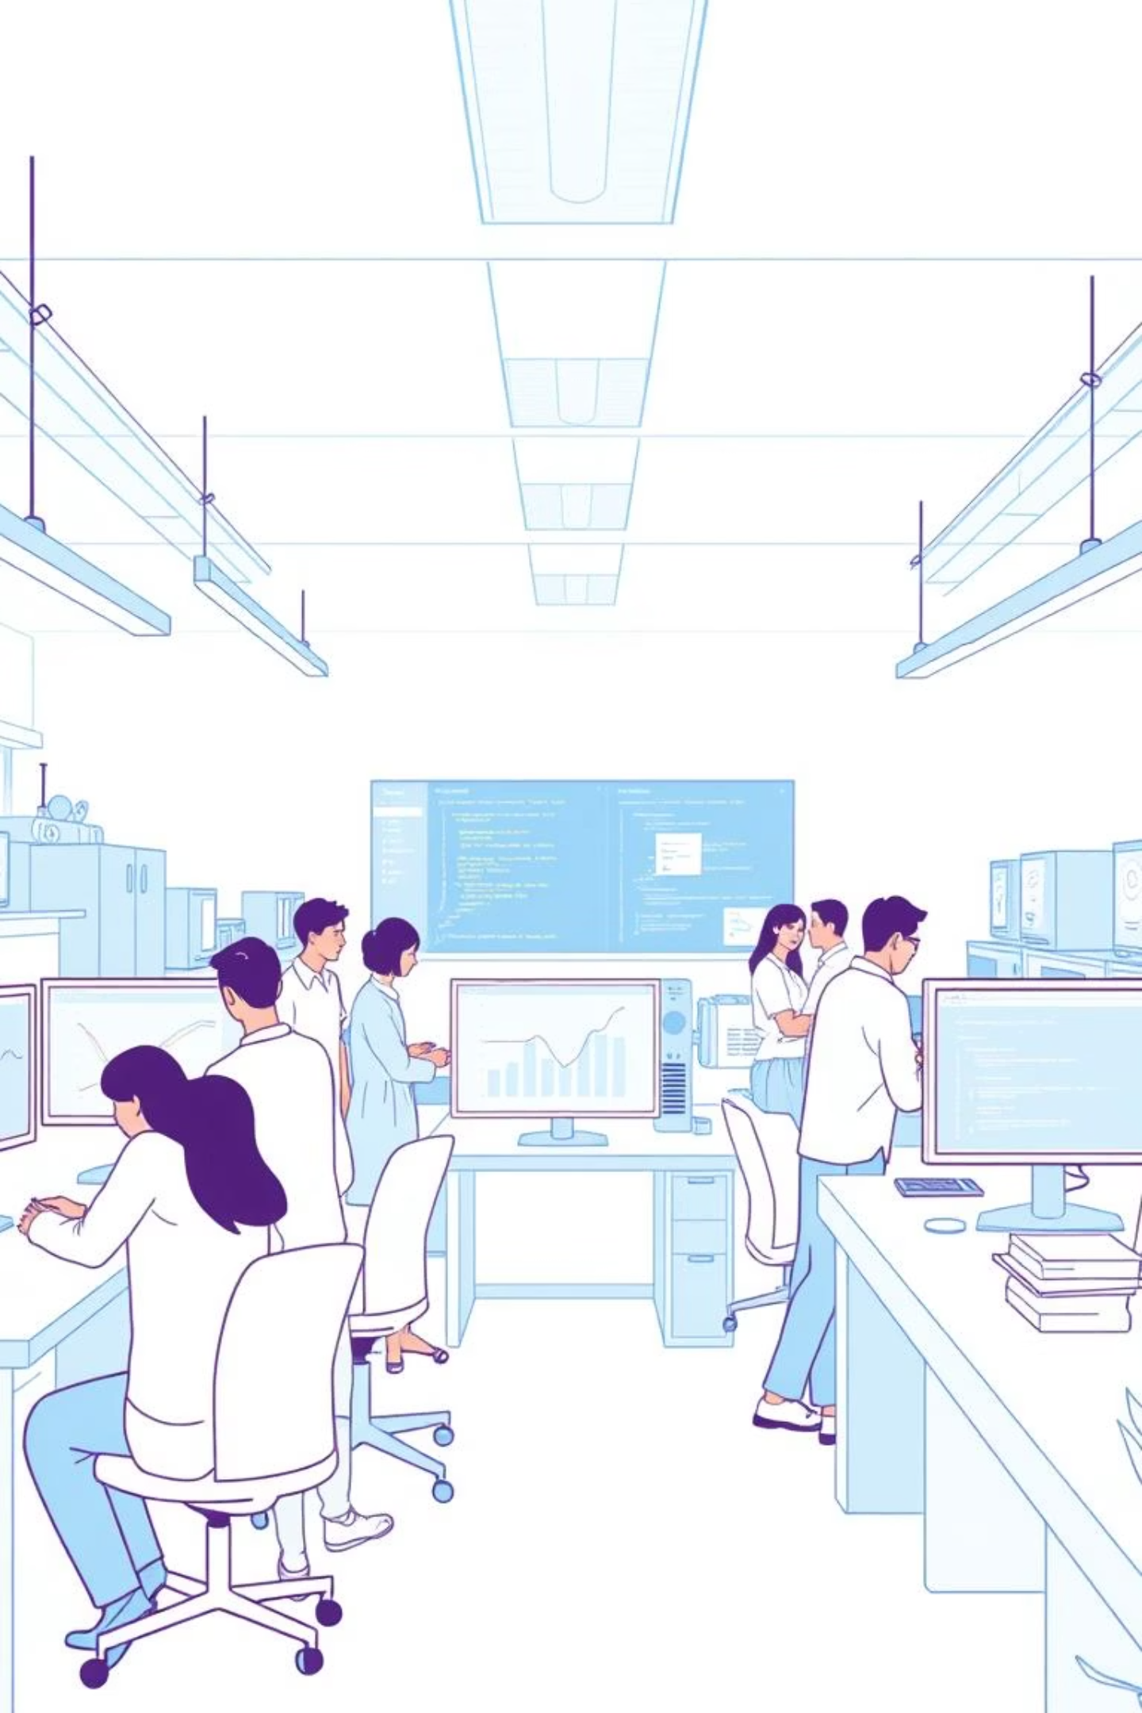
Thank You!!

